Slide 1
Design
Mythos Grant

Slide 2
General
Game Type:
Multiplayer: Primarily local ("couch co-op") with potential for online multiplayer in future updates.
Visual Style:
The game will be 2D or 2.5D, depending on the character models.
The art style will be low-poly, with animations created either through manual frame-by-frame animation or 3D rigging for 2D characters (2.5D).
Data Storage:
Data will be stored locally to minimize loading times and avoid lag spikes. Pre-loading assets will ensure smooth gameplay.
Platform:
Initially designed for PC, but with potential for console compatibility to broaden the player base.
User Interface (UI):
The UI will be minimalist, using simple image layering to maintain the game's aesthetic.

Slide 3
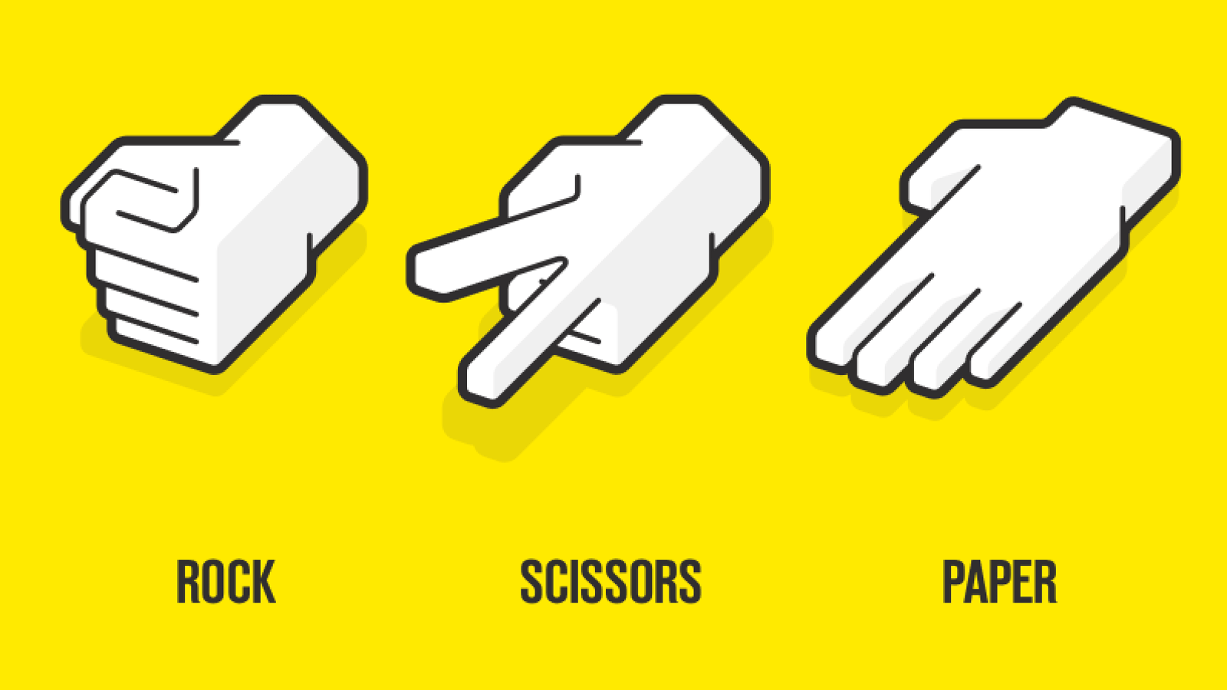
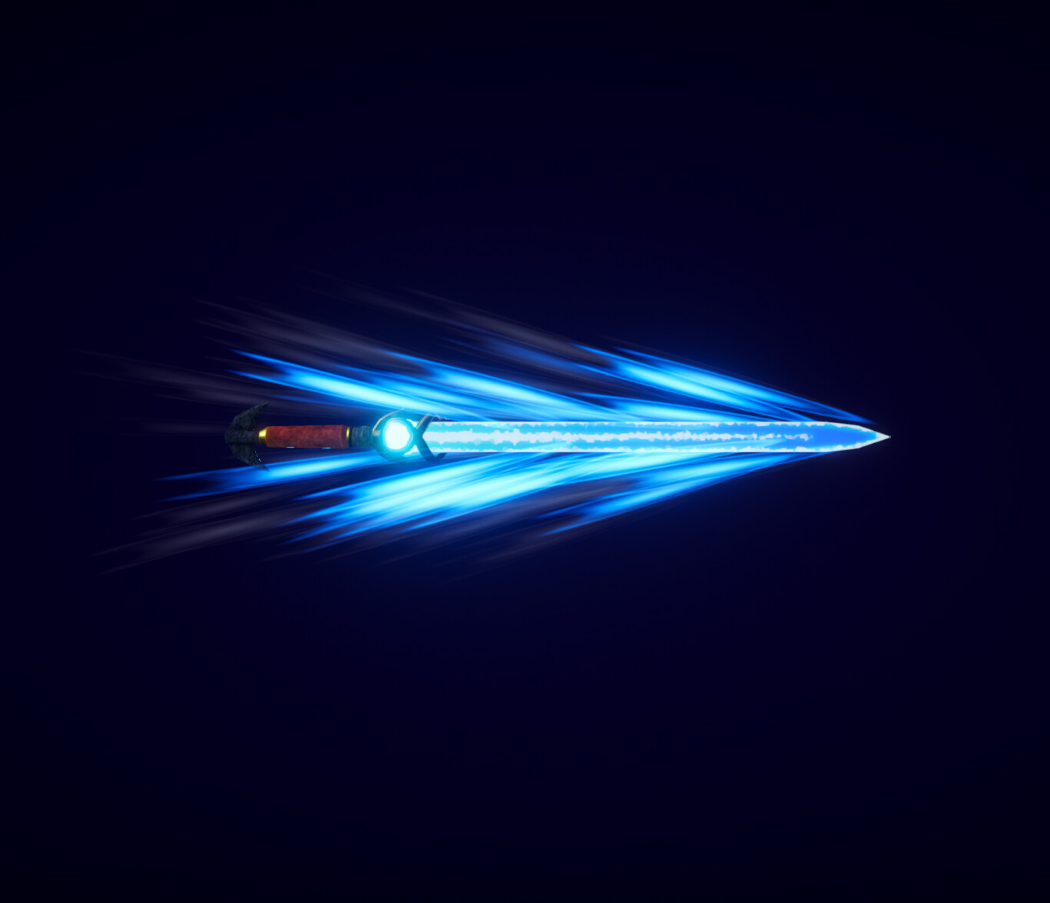
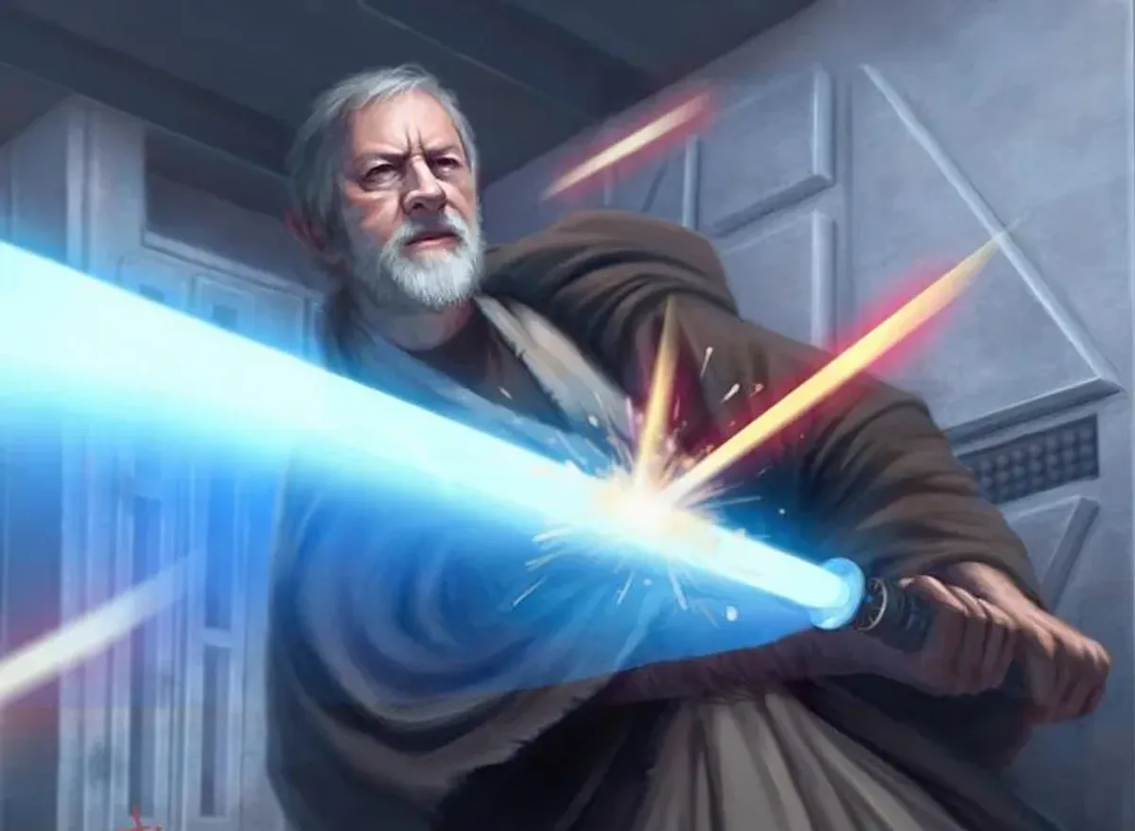
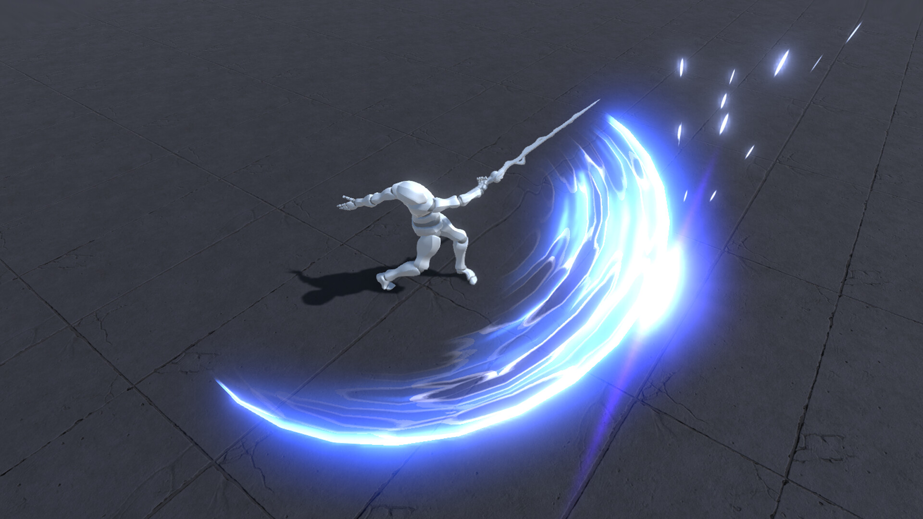
Combat mechanic
Two inputs, swing and focus.
Swing gives momentum and beats parry
Opponent loses grip
Stab is quick and beats swing
Opponent is too slow
Parry can defend against stabs
Opponent was prepared

Slide 4
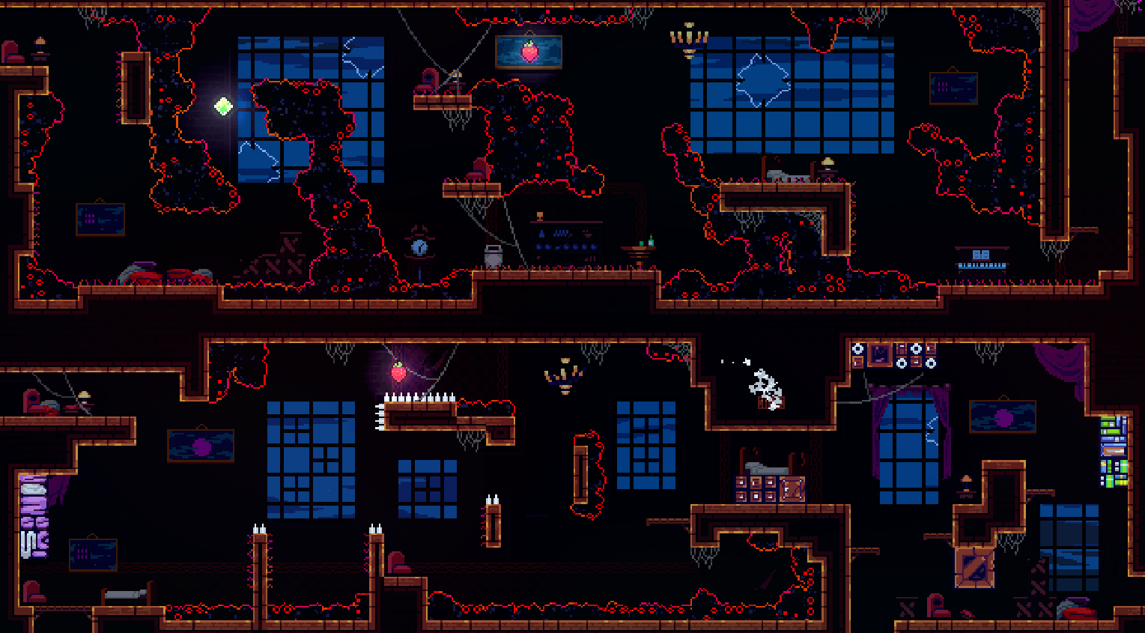
Platforms & movement
Heavily inspired by celeste
Dash will be functionally the same
Stage theme inspired by blend between foreground and background

Slide 5
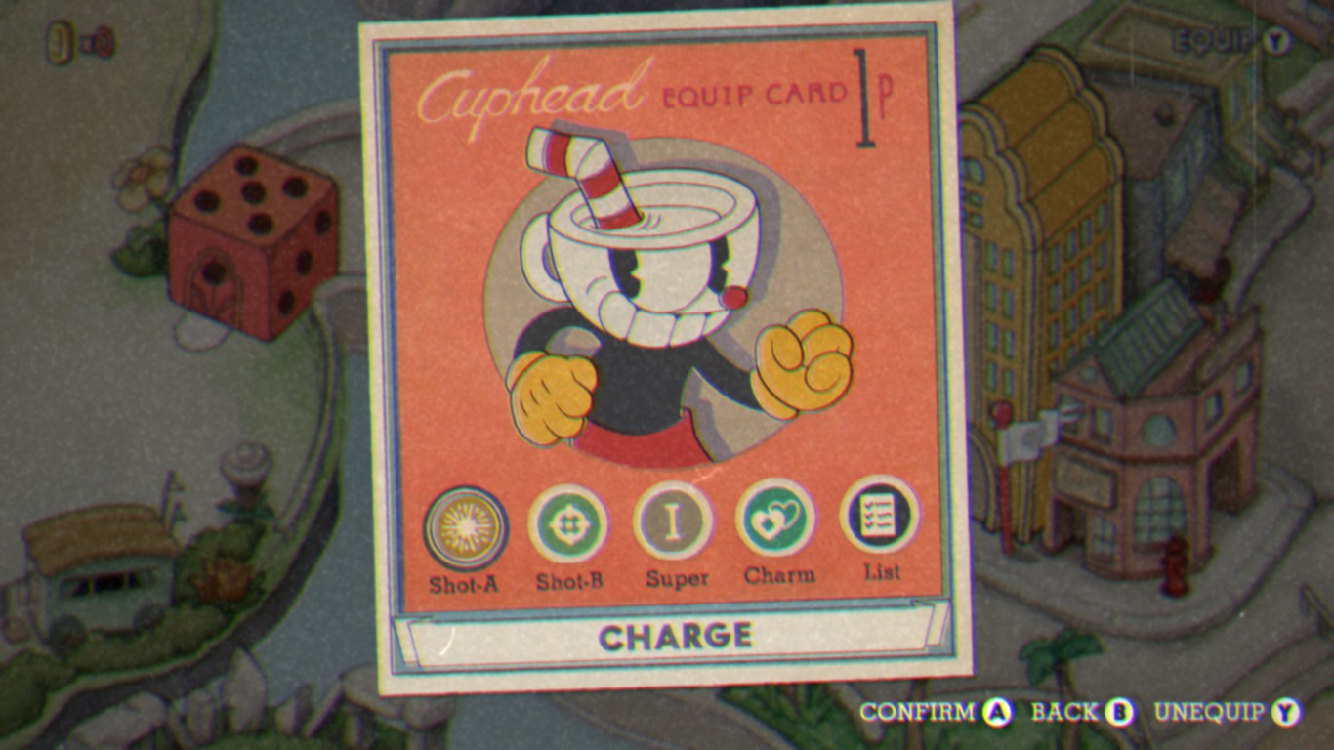
Selection screen
Each player will be able to select :
A sword
Controls
Music
Stage

Slide 6
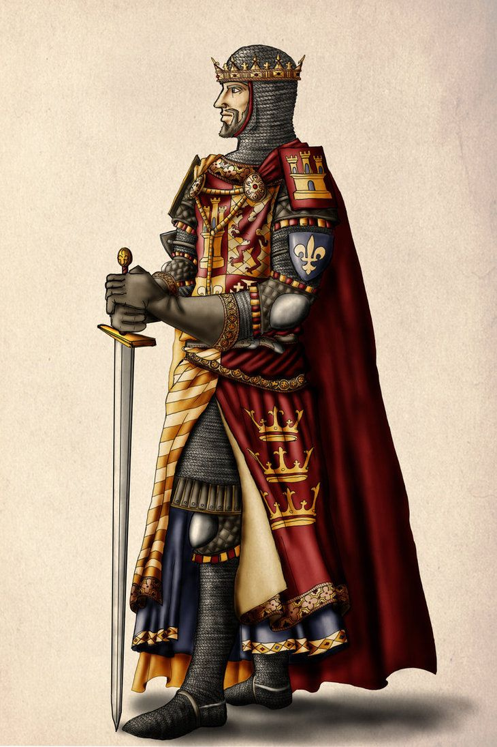
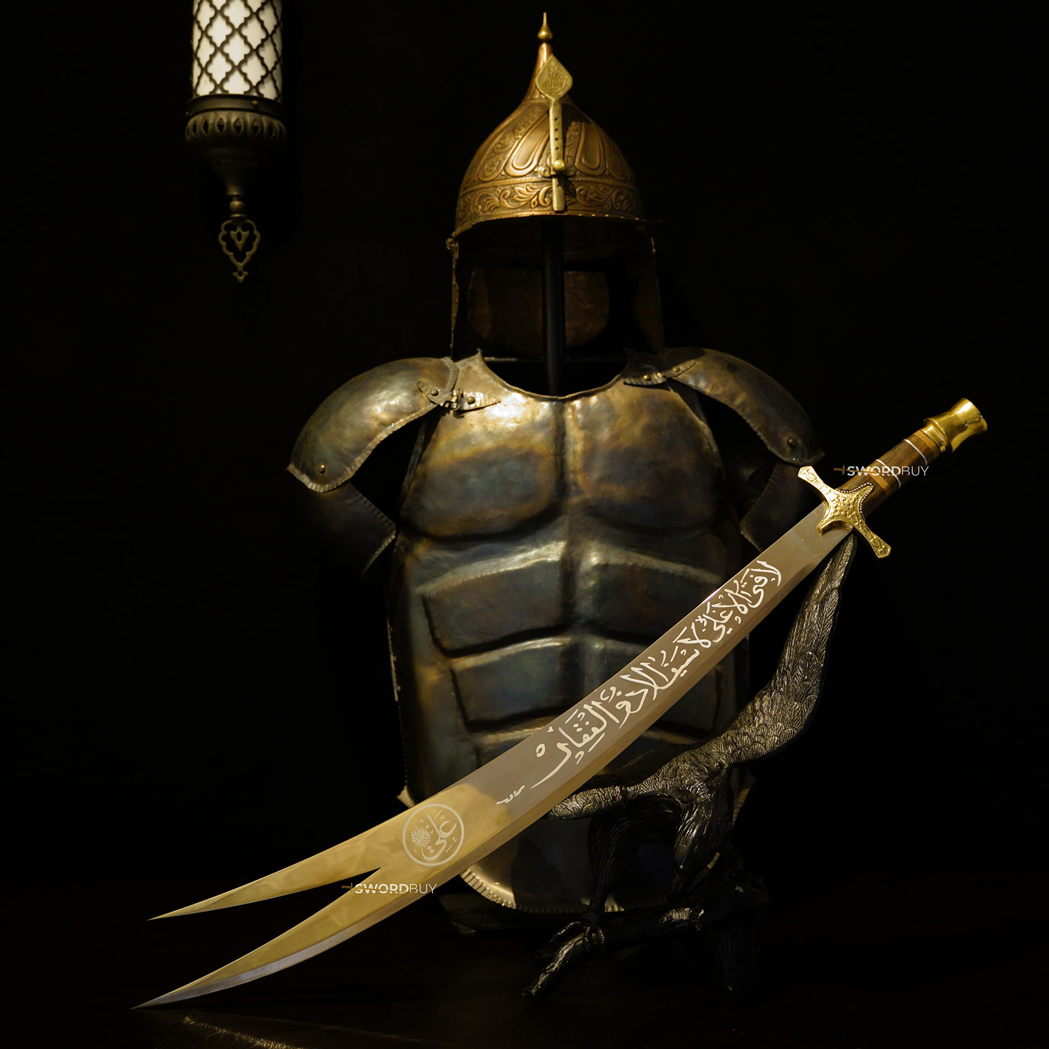
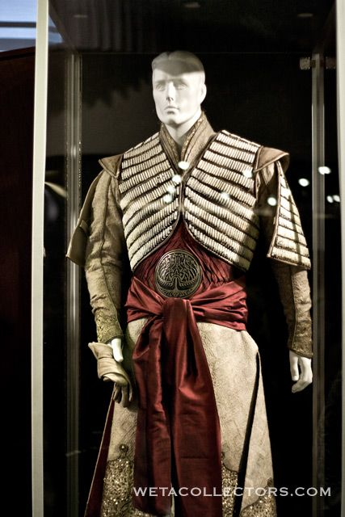
Each grant gets you closer to dominance
Use the grant to gain armor
Influence the next stage
Slowly take over the background as you continue winning.

Slide 7
Assets
Graphics:
Character Models: Low-poly designs, either 2D or 2.5D.
Backgrounds: Unique environments for each stage.
Platforms and Walls: Customizable designs to match the stage themes.
UI Elements: Health bars, menus, and buttons.
Weapon Models: Unique designs for each sword.
Sound:
Background Music: Upbeat electronic music created using AI tools.
Sound Effects: Sword clashes, player damage, dashing, jumping, and stage transitions.
Voice Lines: Short phrases for character entrances and victories.
Other Assets:
Fonts: Easy-to-read, minimalist fonts.
Particle Effects: Sparks for sword clashes, dust for jumps and dashes.

Slide 8
Workflow
Core Mechanics:
Default character, sword, stage, and platform models.
Multiplayer Integration:
Implement local multiplayer functionality
Immersion Mechanics:
Health UI, music, sound effects, and particle effects.
Additional Mechanics:
Menu screens, 8 sword models, 3 stages, and 8 wall designs.

Slide 9
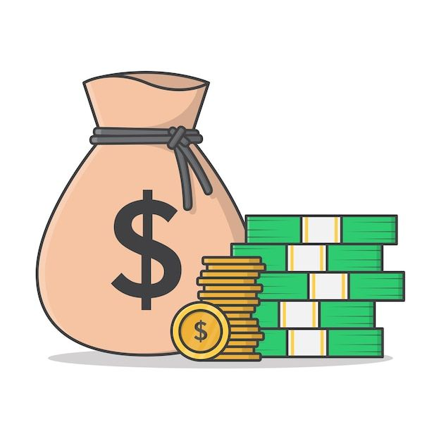
Revenue plan
Self-Publishing:
Publisher Partnership: Pitch the game to a publisher for additional funding.
Release the game at a low cost and focus on marketing through social media and influencers.
Post-Launch Content: Update with new stages, characters, or swords.
Pricing Model:
The game will be free at launch for alpha users to provide feedback, then increased to an adaptable price based on interest.
Marketing Plan:
Social media: Promote the game on platforms like Twitter, Instagram, and TikTok.
Influencers: Partner with gaming YouTubers and Twitch streamers.

Slide 10
Time and scope
Asset Creation
Characters and Swords:
Duration: 1 month (integrated into Production phase).
Start Date: 19.03.2025.
End Date: 18.04.2025.
Stages and Backgrounds:
Duration: 1.5 months (integrated into Production phase).
Start Date: 19.03.2025.
End Date: 22.04.2025.
UI and Sound:
Duration: 1 month (integrated into Production phase).
Start Date: 19.03.2025.
End Date: 22.04.2025.
Training
Task: Learn new tools (e.g., Blender, Godot)
Duration: 2 weeks (integrated into Production phase).
Start Date: 26.02.2025.
End Date: 11.03.2025.
Coding
Core Mechanics:
Duration: 2 months (integrated into Production phase).
Start Date: 26.02.2025.
End Date: 22.04.2025.
Additional Features:
Duration: 1.5 months (integrated into Production phase).
Start Date: 26.02.2025.
End Date: 22.04.2025.

Slide 11
Technical design
Game Engine:
Godot: Chosen for its flexibility, cross-platform support, and ease of use.
Software Tools:
Blender: For 3D modeling.
GIMP: For textures and UI design.
Audacity: For sound editing.
ComfyUI/Fugatto: For AI-generated assets.
Performance Optimization:
Reduce polygon counts for models.
Optimize code to minimize resource usage.

Slide 12

Risks
Technical Risks:
Performance bottlenecks on lower-end hardware.
Networking issues for online multiplayer (if added).
Schedule Risks:
Delays in asset creation or coding.
Budget Risks:
Unexpected costs for tools or assets.
Market Risks:
Competition from similar games.
Changing player preferences.
Mitigation Strategies:
Regular testing to catch issues early.
Flexible timelines to accommodate delays.
Contingency budget for unexpected expenses.

